Slide 1
Technical support center

Slide 2


technical SUPPORT CENTER
A Technical support center, sometimes also called a help desk.
They provide assistance and troubleshooting for technical issues customer’s experience with a company’s products or services.

Slide 3
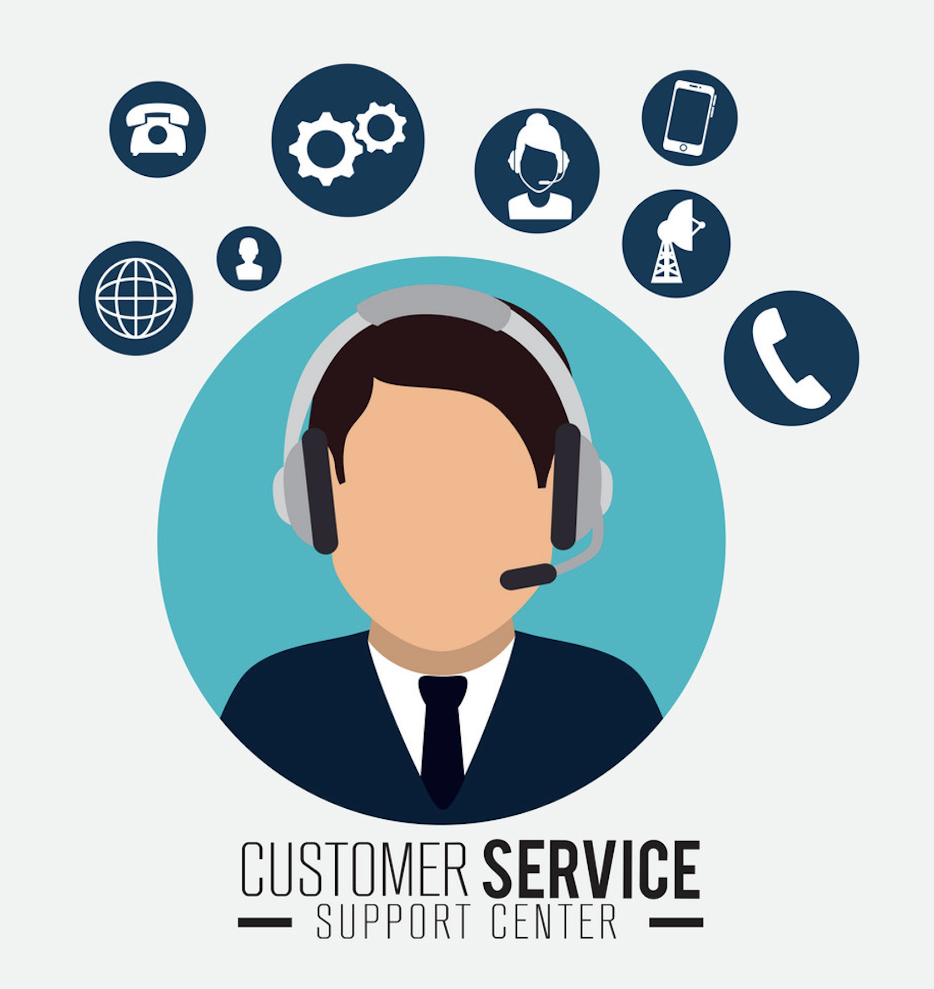
Key functions
Diagnosing and resolving technical issues, such as software glitches, hardware failures, and system malfunctions, through troubleshooting, FAQs, and error guides.
Providing how-to-support and training for new and existing products and features.
Logging and tracking issues to spot trends and common problems.
Escalating complex issues to specialized technical teams.

Slide 4
Business value
Reduce costs by resolving issues quickly and reducing repeat calls.
Improve customer satisfaction by providing self-service options and fast, useful support.
Identify opportunities by spotting trends from logged issues, opportunities for product/feature improvements emerge.
Support adoption of new offerings with training resources and expert help readily available.

Slide 5
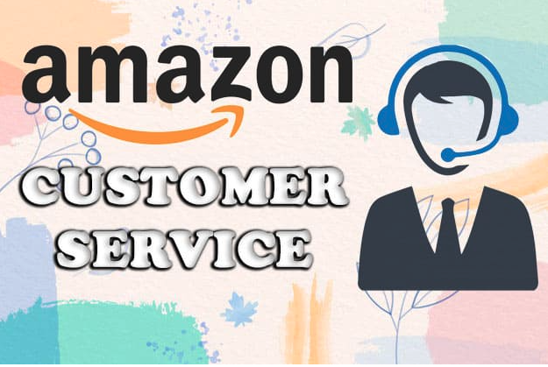
Information on Amazon
Here are some statistics on the customer support volume at major tech companies’ technical support center.
Amazon has over 300 million active customer accounts worldwide.
An estimated value of receiving 3.8 million customer support contacts per day on average, which is 114 million per month.

Slide 6

Information on oracle
Oracle has over 435,000 customers globally across various products and cloud service offerings.
An estimate based on its customer base size could be between 5-10 million customer support cases registered per month across all channels.

Slide 7

Information on google
GOOGLE HAS OVER 1.5 BILLION GMAIL USERS GLOBALLY AS OF 2020 DATA.
IT IS ESTIMATED THAT GOOGLE RECIEVES 271,768 EMAILS PER MINUTE TO ITS GMAIL CUSTOMER SUPPORT, WHICH WORKS OUT TO OVER 390 MILLION EMAILS PER MONTH.

Slide 8

global INDUSTRY SIZE
according TO PROJECTIONS, THE GLOBAL CUSTOMER SERVICE INDUSTRY SIZE WAS APPROXIMATELY $420 BILLION IN 2022
salesforce – THE LEADER IN CUSTOMER RELATIONSHIP MANAGEMENT( CRM ) SOFTWARE GENERATED OVER $26 BILLITION IN REVENUE IN 2022, WITH SUPPORT SERVICES A KEY ELEMENT.
IBM – GENERATES REVENUE OF AROUND $60 BILLION IN TECHNICAL SUPPORT & SERVICES
ORACLE - SUPPORT REVENUES WERE AROUND $7.40 BILLIN IN 2022

Slide 9

WHY SIMULATION FOR SUPPORT CENTERS
FORECAST STAFFING NEEDS AND SERVICE LEVELS AS THIS ENSURES THAT IT HAS ADEQUATE RESOURCES.
IDENTIFY PROCESS BOTTLENECKS AS SIMULATION CAN PINPOINT WHERE DELAYS OCCUR WHETHER DUE TO IMPROPER STAFF LEVELS, INADEQUATE SKILLS/TRAINING, FLAWED PROCEDURES OR TECHNOLOGY ISSUES.
MAKING CHANGES TO A REAL SUPPORT CENTER CAN INVOLVE BUSINESS RISKS IF IT NEGATIVELY IMPACTS OPERATIONS.
OPTIMIZE EFFICIENCY.
SIMULATION ALLOWS STRESS TESTING FOR PEAK PERIODS LIKE NEW PRODUCT LAUNCHES OR MAJOR OUTAGES.

Slide 10
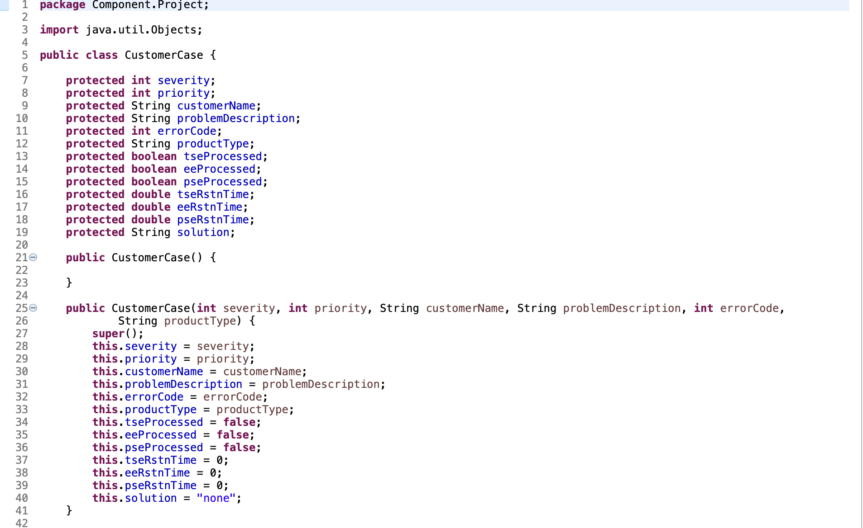
Customer case model
Severity
Priority
Customername
Problemdescription
Errorcode
Producttype
solution

Slide 11
Key attributes of a support case
Severity level (1-5): Measures the impact of the issue on system/product functionality from minor ( 5 ) to complete disruption ( 1).
Priority level (1-5): Urgency based on severity, customer sla, and importance. 5 = low impact and 1 = needs immediate attention.
Customer name: The individual or company experiencing the issues. Some customers are standard or ordinary whereas some are premium.
Problem description: free text detailing behaviors, steps to reproduce, relevant context.
Error code (100-150): System-generated code categorizing specific error conditions.
Product type: classifies product line, component with issue
Proposed solution: suggested fix for evaluation to resolve a case.

Slide 12
Contrasting severity vs priority
Severity means technical impact and doesn’t directly account for time or customer sla’S.
PRIORITY INCORPORATES BUSINESS IMPACT BY AKSING TWO CRITICAL QUESTIONS:
HOW URGENT IS FAST RESOLUTION FOR THIS CUSTOMER BASED ON THEIR SUPPORT LEVEL AGREEMENT?
WHAT IS THE BREADTH OF IMPACT – HOW MANY OTHER PROCESSES, CUSTOMERS, OR CAPABILITIES DOES IT DISABLE?

Slide 13
Leveraging knowledge to resolve cases:
Product documentation: Technical manuals detailing api usage, architecture, component interactions, breakdown of subsystems.
Known defects database information system that keeps track of already reported or identified defects and bugs in products.
Existing solutions library searchable knowledge base of customer scenarios mapped to vetted solutions, drawn from historical cases, release notes, field escalations.
Configuration references optimal configuration settings for components.

Slide 14
Template of knowledge base articles
Title: <xxxx>
Metadata taxonomy tags:
Product
Version
Environment
Symptoms: <yyyy>
Cause: <zzzz>
Affected users: <aaaa>
Steps to reproduce: <Rrrr>
Workarounds: <wwww>
Solution: <ssss>

Slide 15
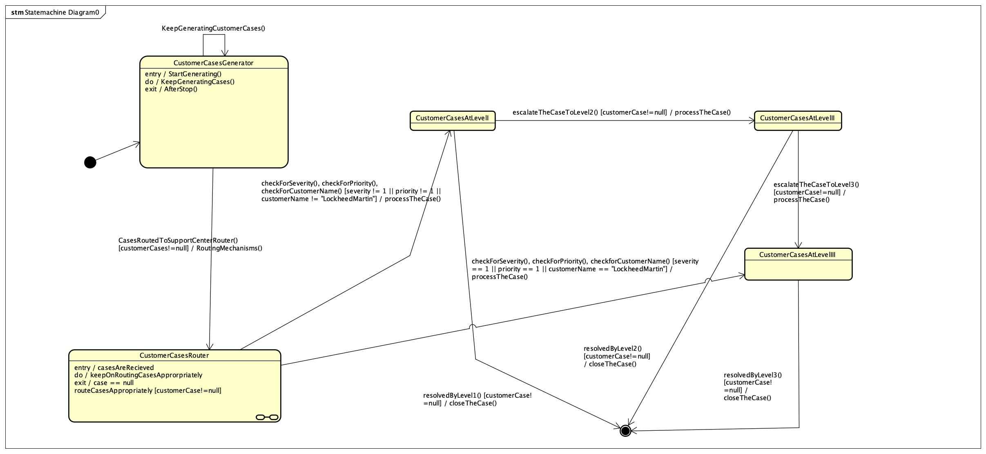
Customer case state machine
Initial State
CustomerCaseGenerated
CustomerCasesRouted
CustomerCaseAtLevel1
CustomerCaseAtLevel2
CustomerCaseAtLevel3
Final/Terminating State

Slide 16
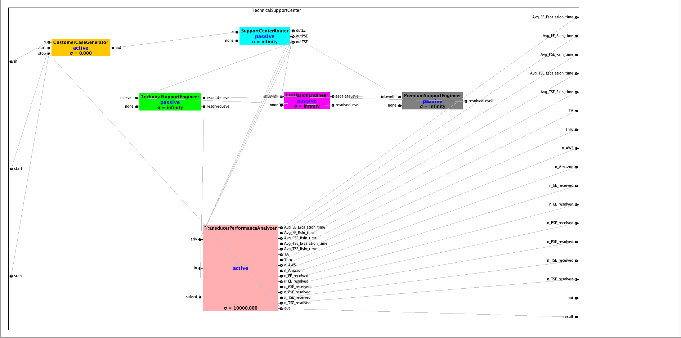
Coupled model: technical support center

Slide 17

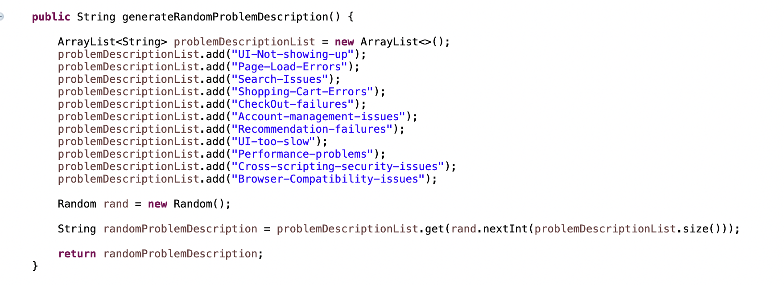
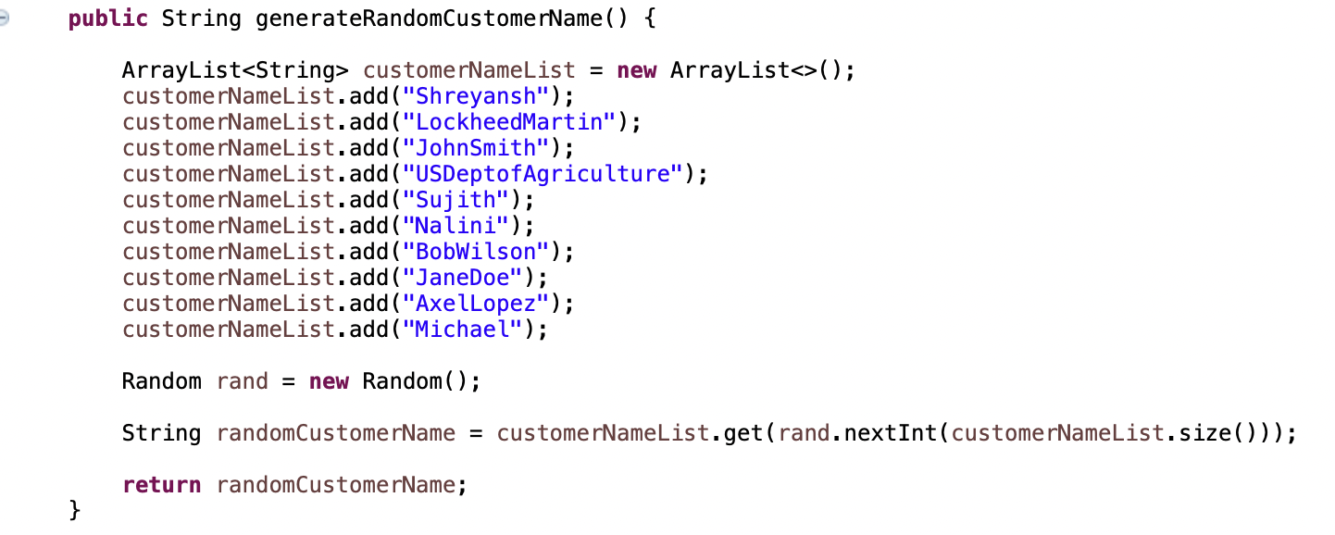
Component: case generator
This represents a component that randomly generates customer support cases. It is designed to simulate the arrival of new support tickets in a customer service system.
Each generated case contains attributes like priority, severity, customer name, product type, error code, problem description, etc. the values for each are randomly generated each time.

Slide 18
component: support cENTER router
rOUTES INCOMING CUSTOMER SUPPORT CASES TO THE APPROPRIATE SUPPORT PERSONNEL.
cHECKS FOR THESE ATTRIBUTES severity, Priority and customer name.
Routes high sev/Pri and premium customers directly to pse.
Routes medium sev/pri cases to ee.
Routes low sev/pri cases to tse.
Maintains separate queues for cases routed to pse, ee and tse.

Slide 19
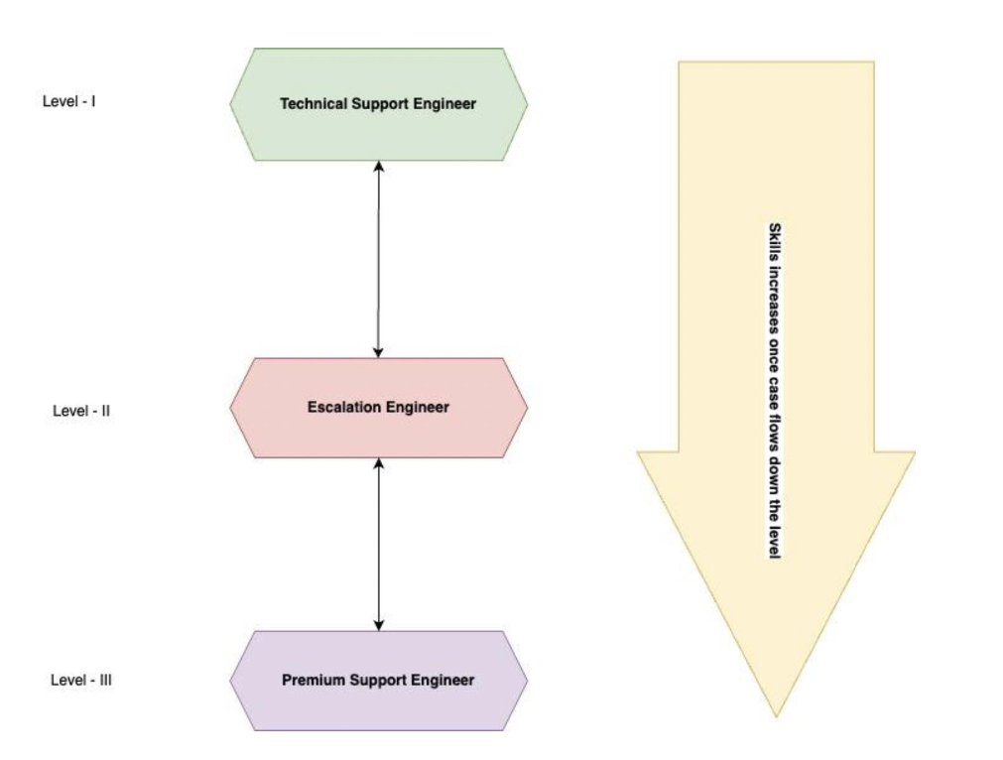
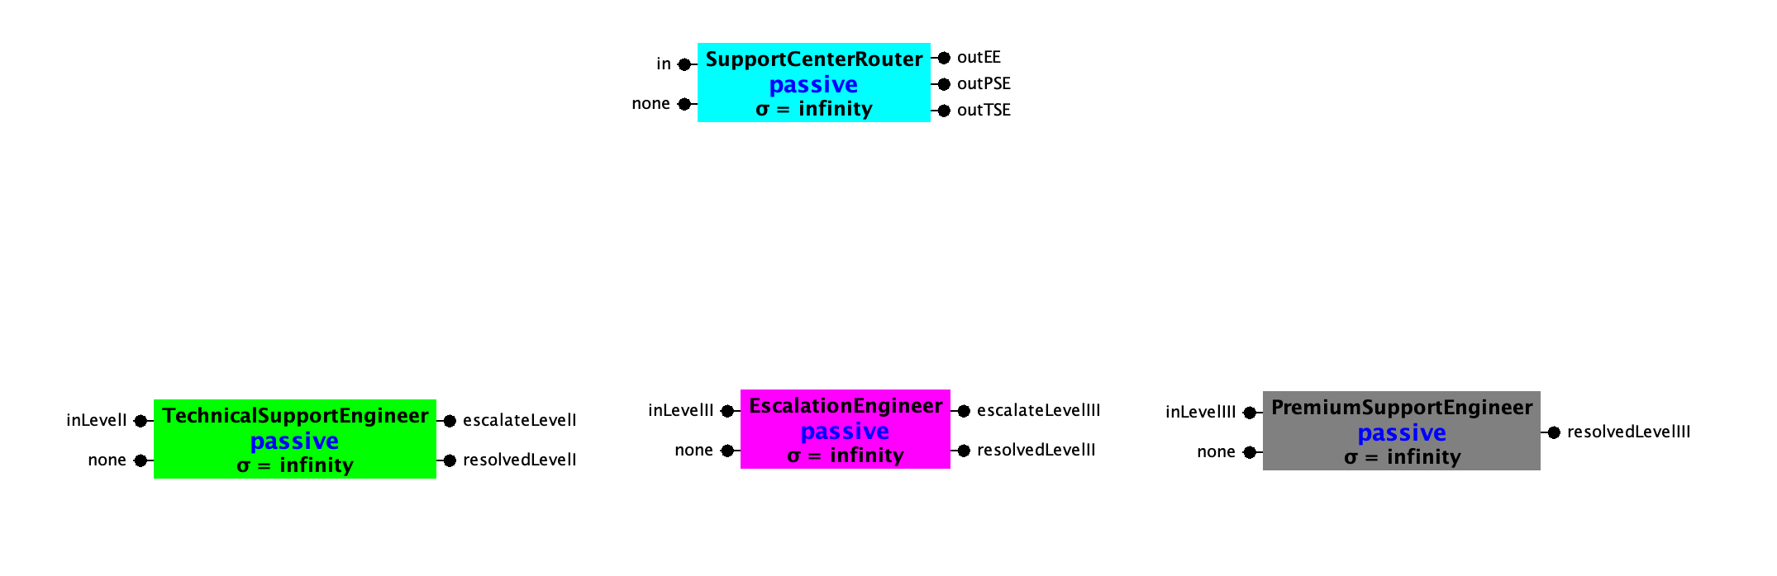
Support personnel
Level I: Technical support ENGINEER ( TSE )
LEVEL 2: ESCALATION ENGINEER ( EE )
lEVEL 3: PREMIUM SUPPORT ENGINEER ( PSE )

Slide 20
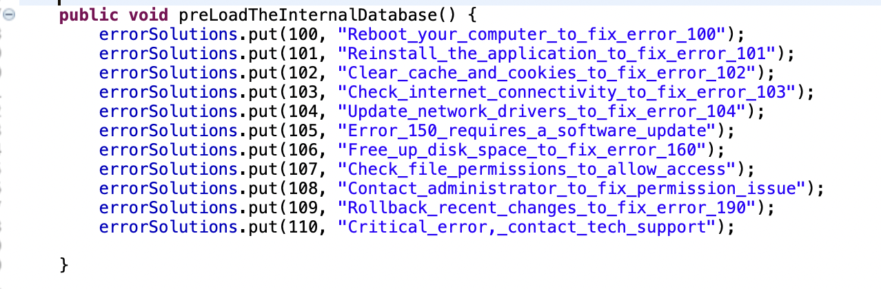
TSE : Technical support engineers
This is the lowest tier within the support organization, characterized by a limited scope of
knowledge that is confined to pre-existing faults or bugs

Slide 21
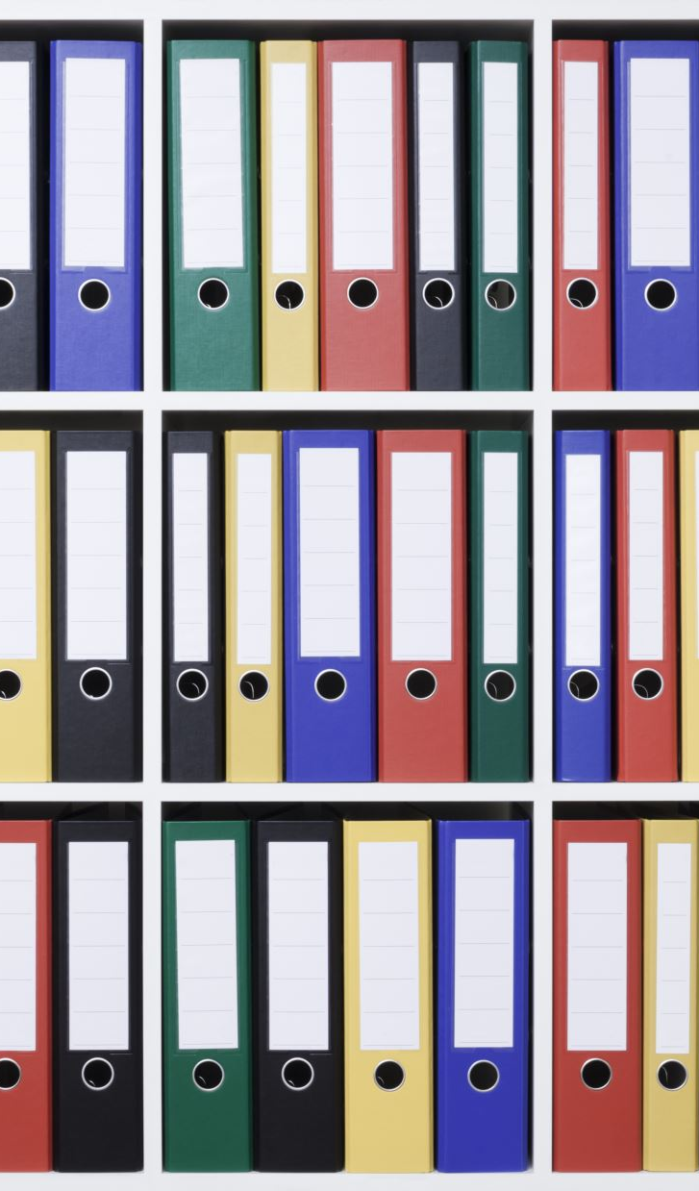
EE: Escalation engineer
Thoroughly investigate issue to determine if it is a system fault.
Identify and provide relevant documentation or knowledge base articles to help resolve issues.
Leverage list of known workaround/solutions for specific error codes or issues.
Broad familiarity with product documentation & kb articles.
Follow fifo queue to ensure fair case pick up order.

Slide 22
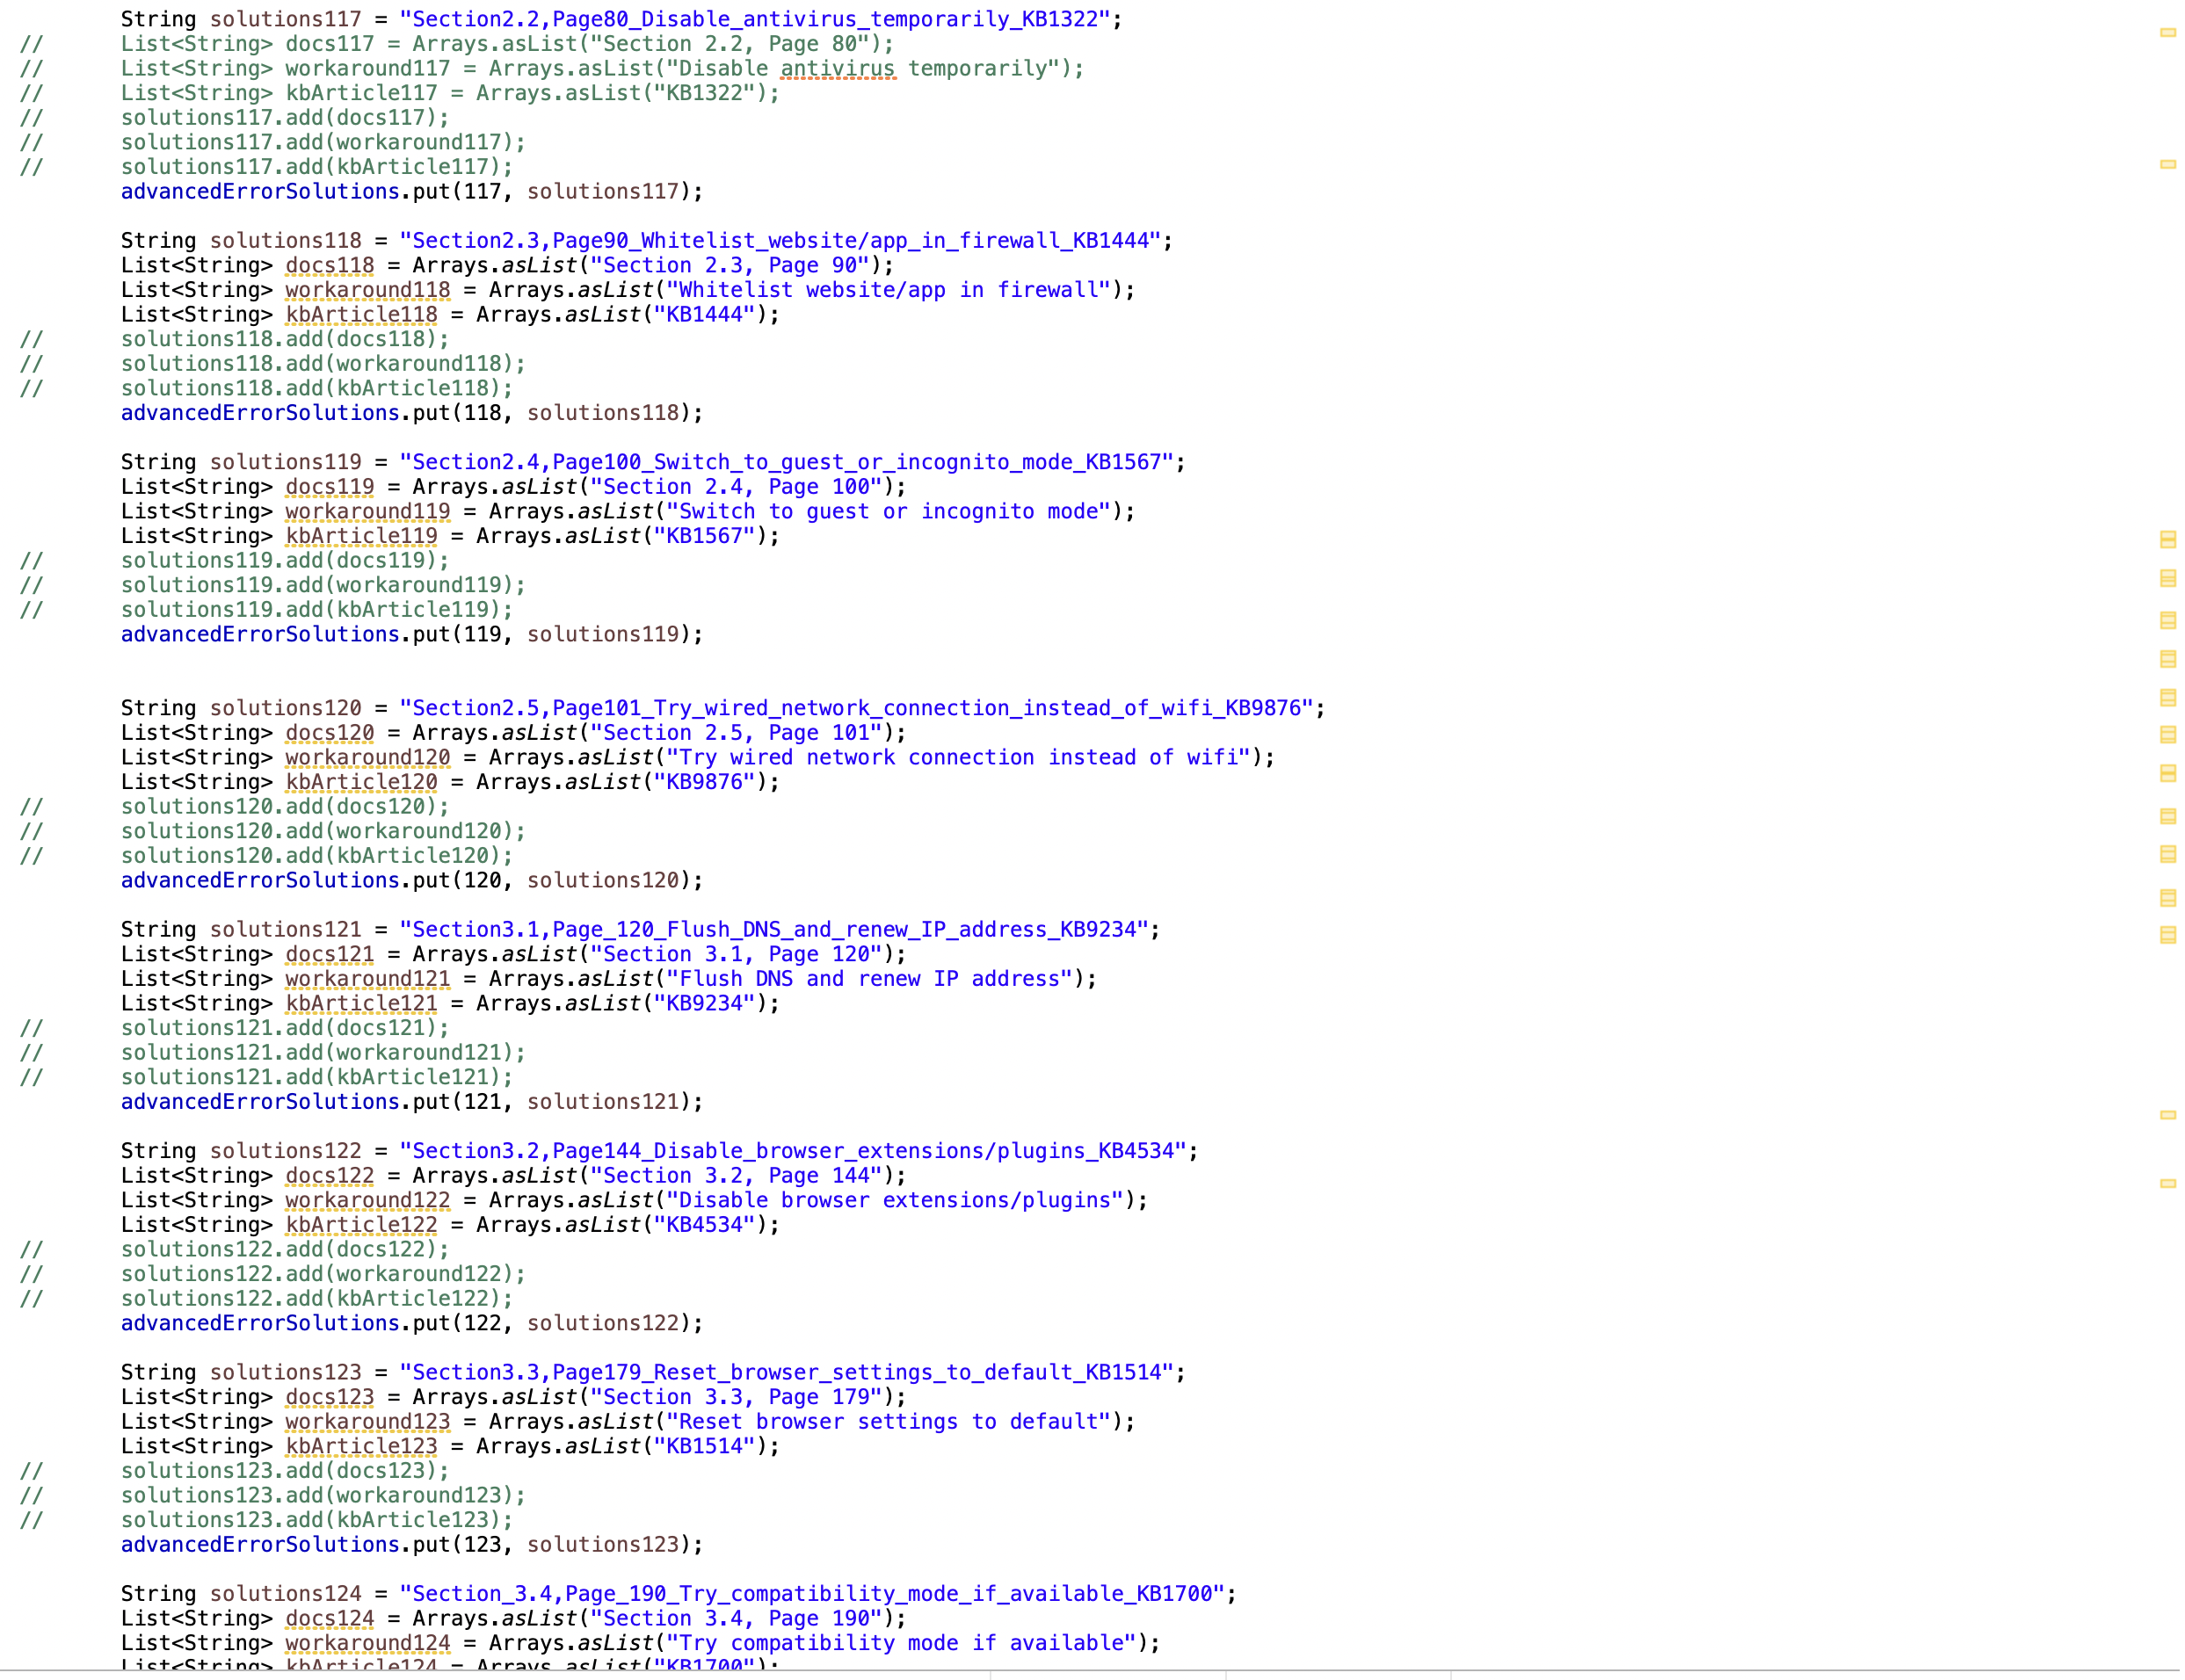
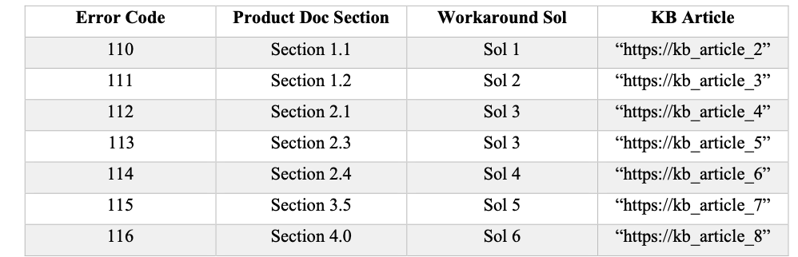
Ee: leverages advanced knowledge

Slide 23
Pse: Premium support engineer
Highest level of product expertise
In-depth understanding of architecture, code base.
Ability to dive into source code to uncover and fix bugs.
Highest case resolution probability – nearly 100%.
Critical for customer retention and issue prevention.
Improve product quality by identifying and fixing code defects.

Slide 24
Feedback mechanisms b/w support personnel

Slide 25
EXPERIMENTS

